Slide 1

Sleep Health Exploratory Analysis
Josh Brauner, Raahim Salman, Ze Yu

Slide 2
Introduction
Sleep is critical, occupying ~1/3 of our lives
Sleep benefits are numerous
Physical health
Mental well-being
Cognitive performance
Safety
ISRUC Sleep Dataset is aimed towards researchers studying sleep including
Sleep patterns
Sleep disorders
Effects of medication on sleep

Slide 3
Motivation
Understanding sleep disorders
Impact on health

Slide 4
Guiding Questions
How do age and gender affect sleep hours?
What other factors impact sleep quality?
How does health status (ex. BMI) impact sleep hours and resting heart rate?
How do sleep disorders impact quality and hours of sleep?

Slide 5
Dataset
General Population Data:
100 subjects, one recording each
Polysomnogram analyzed by two experts for sleep stage data
Demographics of subjects included
Healthy Subject Data:
10 healthy subjects, one recording each
Polysomnogram analyzed by two experts for sleep stage data
Demographics of subjects included
Sleep stage and event data organized into epochs:
30 seconds each
Includes sleep stages, HR, SpO2

Slide 6

Results

Slide 7

Guiding Question 1
How do age and gender affect sleep hours?

Slide 8
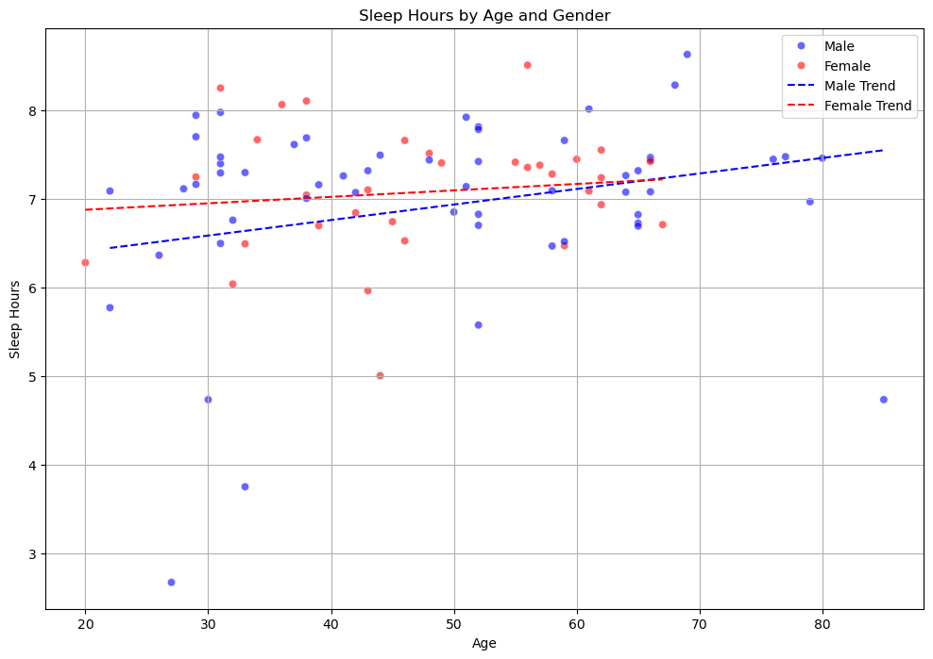

Slide 9
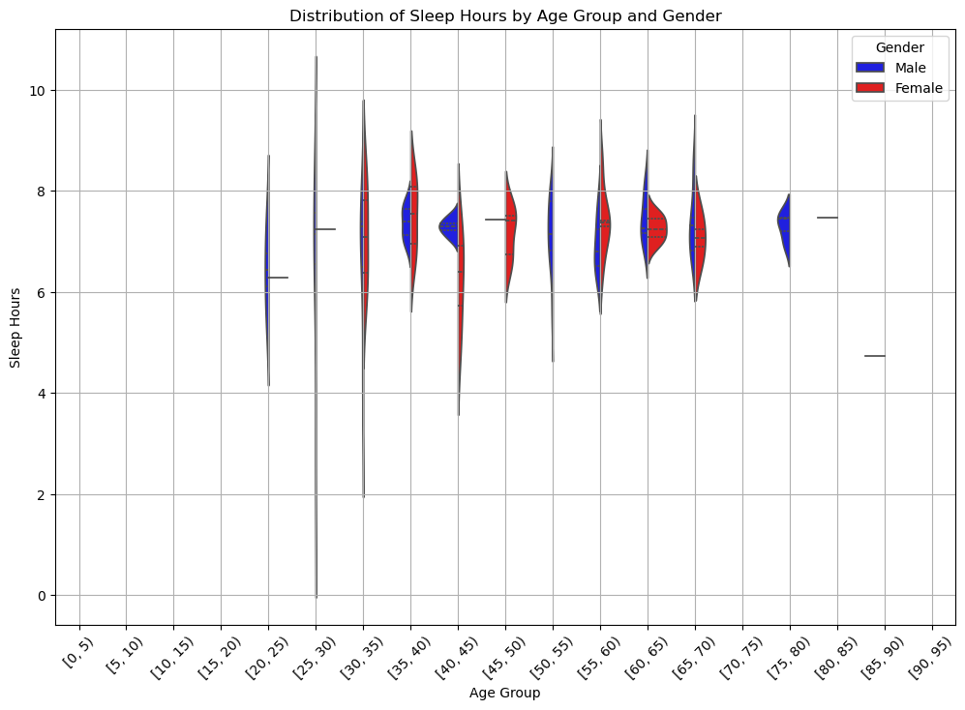

Slide 10

Guiding Question 2
What other factors impact sleep quality?

Slide 11
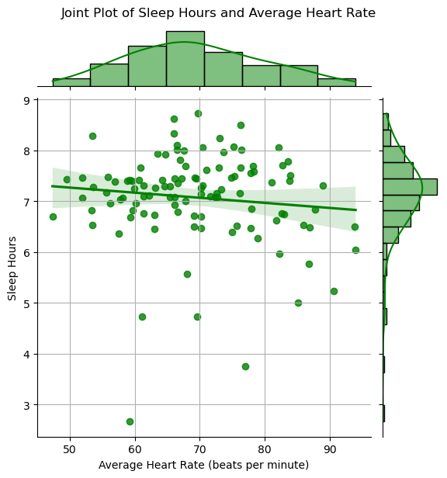

Slide 12
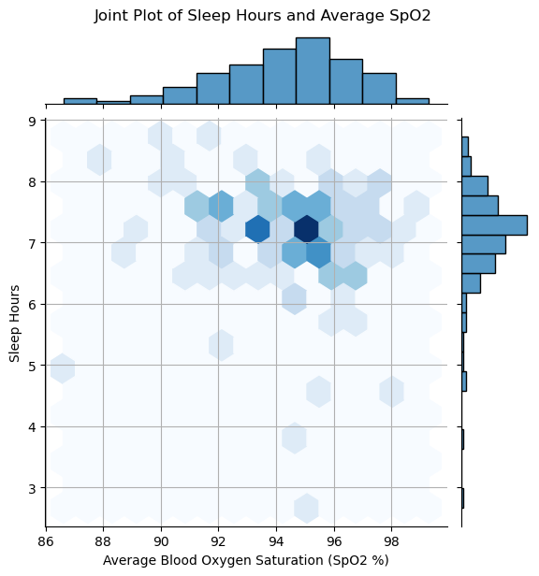

Slide 13
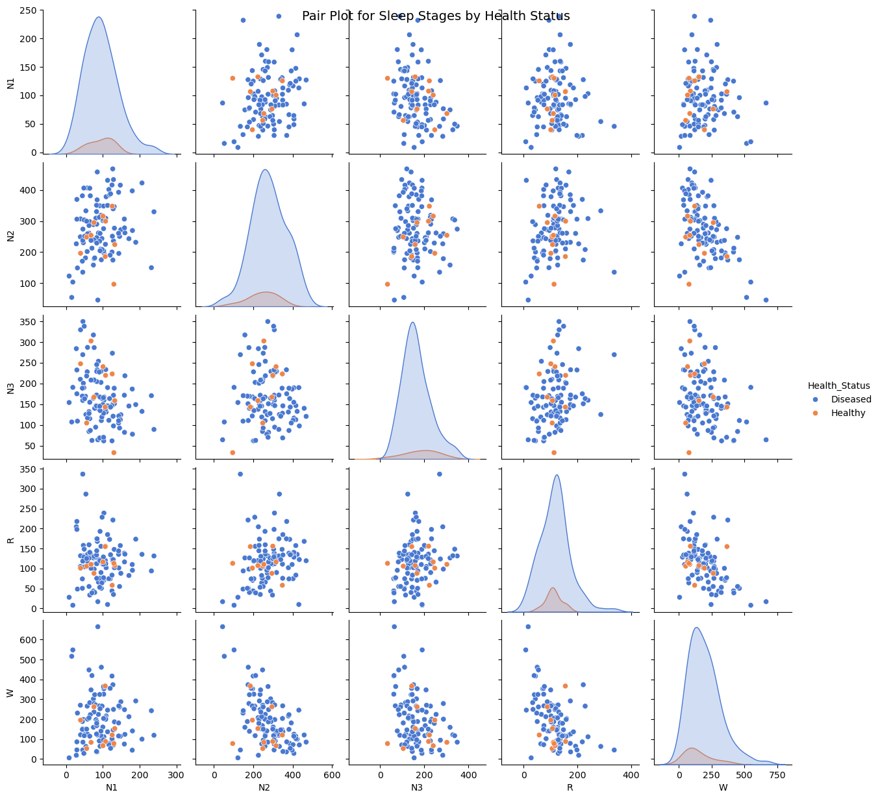

Slide 14
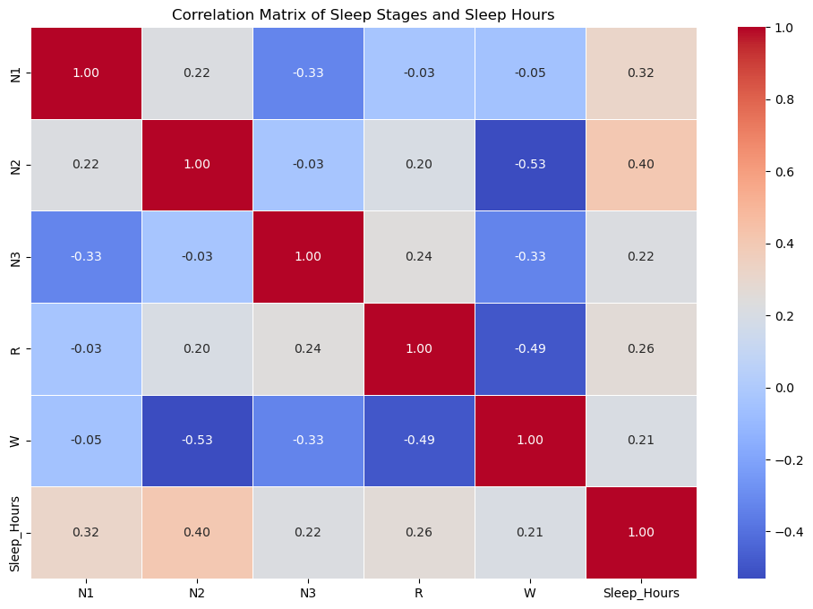

Slide 15
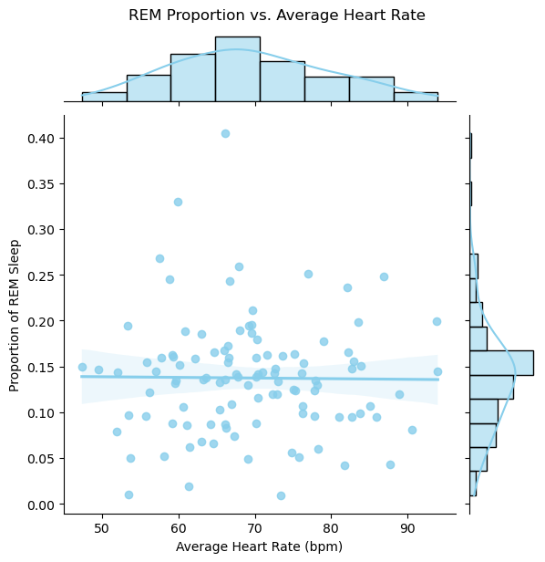

Slide 16
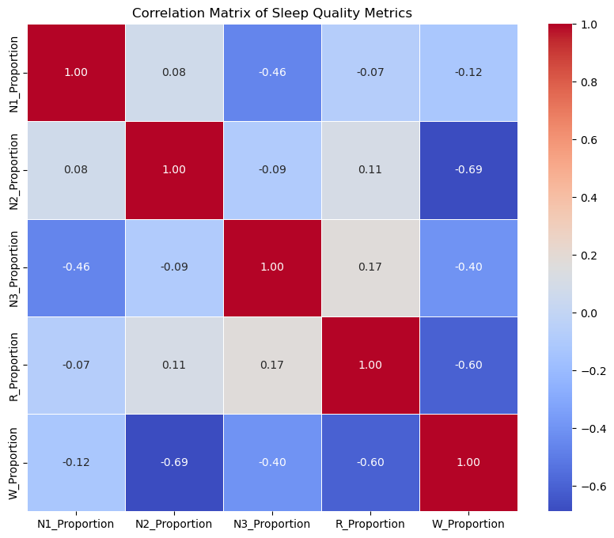

Slide 17
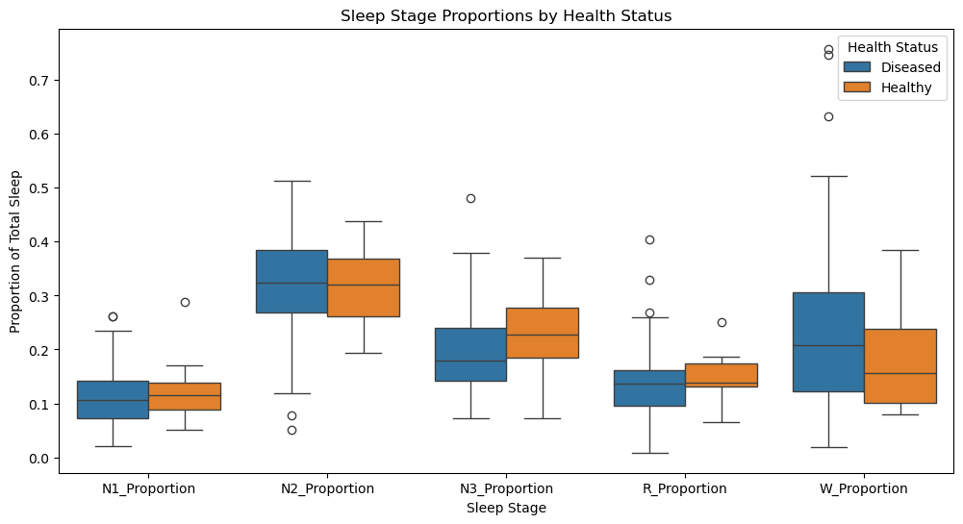

Slide 18

Guiding Question 3
How does health status (ex. BMI) impact sleep hours and resting heart rate?

Slide 19
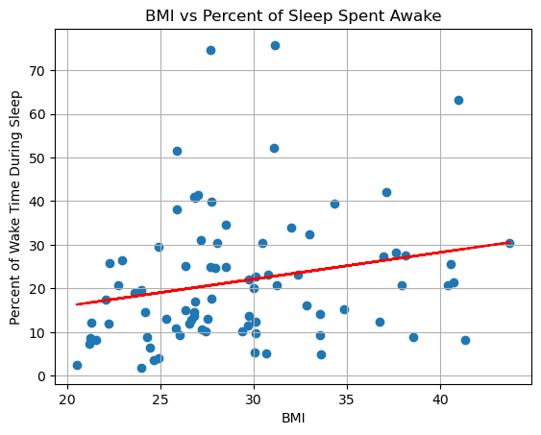

Slide 20
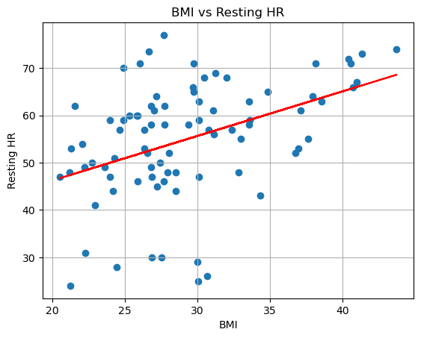

Slide 21
Guiding Question 4
How do sleep disorders impact quality and hours of sleep?

Slide 22
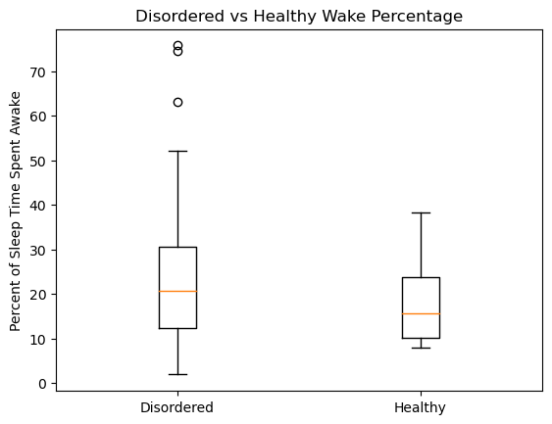

Slide 23
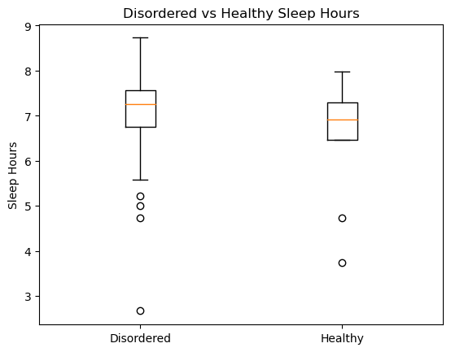

Slide 24

Conclusions

